Slide 1
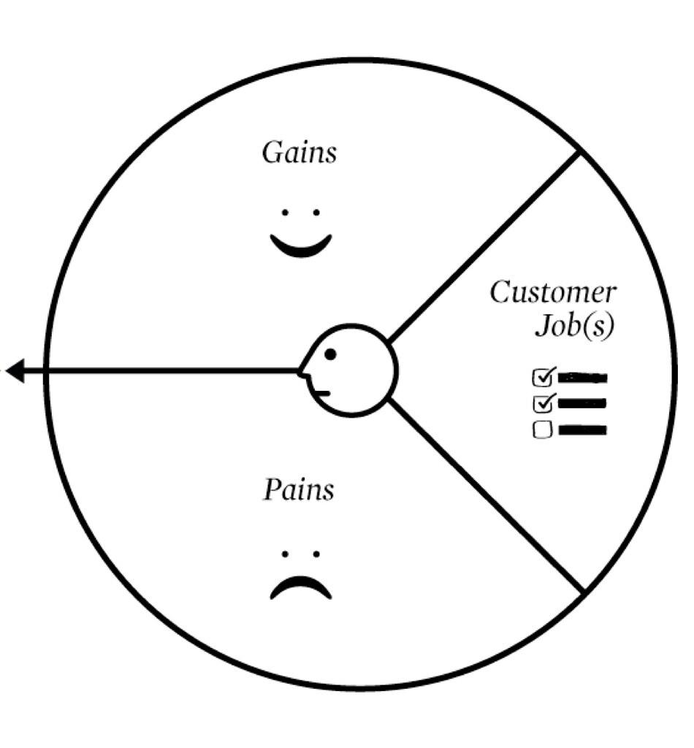
Customer Profile
profile name
GAINS
CUSTOMER JOB(S)
PAINS

Slide 2
Customer Profile
profile name
GAINS
Positive emotions expected by your customer. Benefits, social gains, cost savings…
Ask yourself:
•How do current solutions delight your customer?
•What do customers dream about?
•What would make your customer’s life easier?
•What outcomes does your customer expect & what exceeds his expectations ?
CUSTOMER JOB(S)
What jobs the targeted customers are trying to get done? Tasks to complete? Needs to satisfy? Problems to solve?
Ask yourself:
•What functional jobs is your customer trying get done?
•What social jobs is your customer trying to get done?
•What emotional jobs is your customer trying get done?
•What basic needs is your customer trying to satisfy?
PAINS
Negative emotions, undesired situations & risks that your customer could experience trying to get the job done:
Ask yourself:
•What are the main difficulties and challenges your customer encounters?
•What is too costly for your customer?
• What risks does your customer fear?
• What common mistakes does your customer make?

